Slide 1
EHR

Slide 2



Scan the code to secure your attendance – no scans, no proof you were here!

Slide 3
Introduction to EHR
Definition: EHR is an individual's official health document shared among multiple facilities and agencies.
Importance: Growing influence due to digitalization and mobile access demands.

Slide 4
Typical Data Included in EHRs
Key Elements of EHRs:
- Contact information
- Visits to healthcare professionals
- Allergies, vital signs, lab/radiology results
- Family medical history, immunizations, medications, surgeries
- Insurance information, hospitalization records, attached medical images

Slide 5
Benefits of EHRs (Overview)
Main Benefits for Patients & Healthcare Organizations:
- Improved care coordination
- Increased efficiency
- Enhanced emergency care
- Better data access and engagement
- Cost savings and population health management

Slide 6
EHR Benefit - Care Coordination
Description: Standardization in services and patient care, leading to improved outcomes.
Benefit: Quick access to comprehensive patient data, enabling informed decisions.

Slide 7
EHR Benefit - Efficiency
Description: Streamlined processes for scheduling, billing, refills, and communications.
Benefit: Faster sharing of multimedia information, including imaging results.

Slide 8
EHR Benefit - Emergency Care
Description: Instant access to critical records (allergies, medications).
Benefit: Ability for healthcare providers to make life-saving decisions quickly.

Slide 9
EHR Benefit - Access to Data
Description: Secure, accessible data for patients and providers.
Benefit: Encourages patient involvement in health management.

Slide 10
EHR Benefit - Cost Savings
Description: Reduced need for paper systems and administrative redundancy.
Benefit: Long-term savings and efficient storage of medical records.

Slide 11
Global EHR Adoption
Global Efforts: Governments pushing for standardized EHRs.
Challenges: Cost and privacy barriers; security concerns in some regions.

Slide 12
EHR Regulations in the U.S.
Overview: CMS and ONC set standards for EHR platforms.
Requirements: Interoperability, data security, and meaningful use compliance.

Slide 13
EHR Standards and Interoperability
Purpose of Standards: Facilitate seamless data exchange.
Key Standards: HL7, FHIR, SMART Health IT, DICOM (European standards).

Slide 14
EHR vs. EMR (Electronic Medical Record)
Distinction: EHR (comprehensive and shared) vs. EMR (limited to specific providers).
Usage: ONC uses EHR exclusively.

Slide 15
EHRs vs. Paper Records
Comparison of Key Aspects:
- Time, environment, security, cost, access, readability/accuracy
- Advantages and drawbacks for both methods.

Slide 16
Common Features of EHR Systems
Patient Portals: Access for patients and secure data sharing.
Order Management: Medication, diagnostic tests, and interaction alerts.
Workflow Management: Scheduling, clinician coordination.
Administrative Support: Coding for clinical, financial, and service claims.

Slide 17
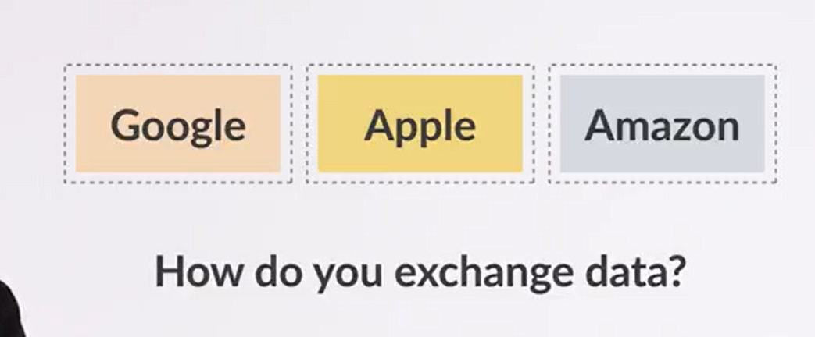

Slide 18
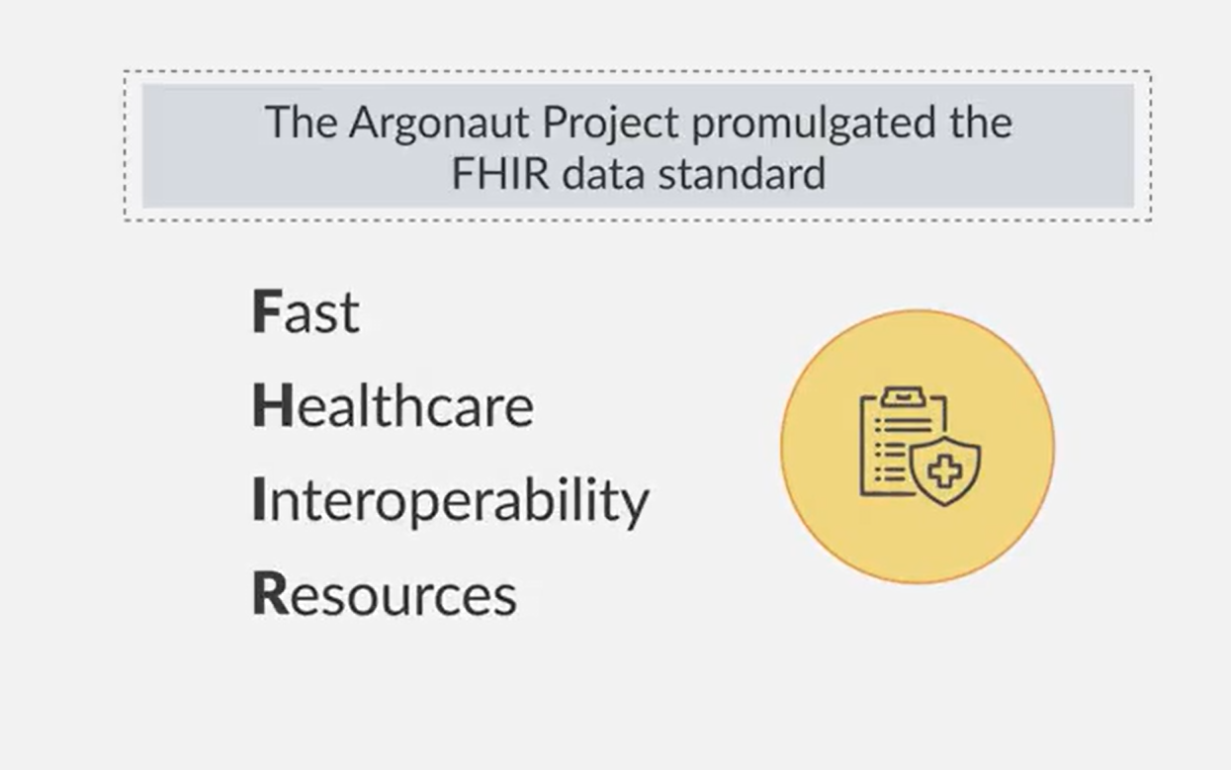

Slide 19
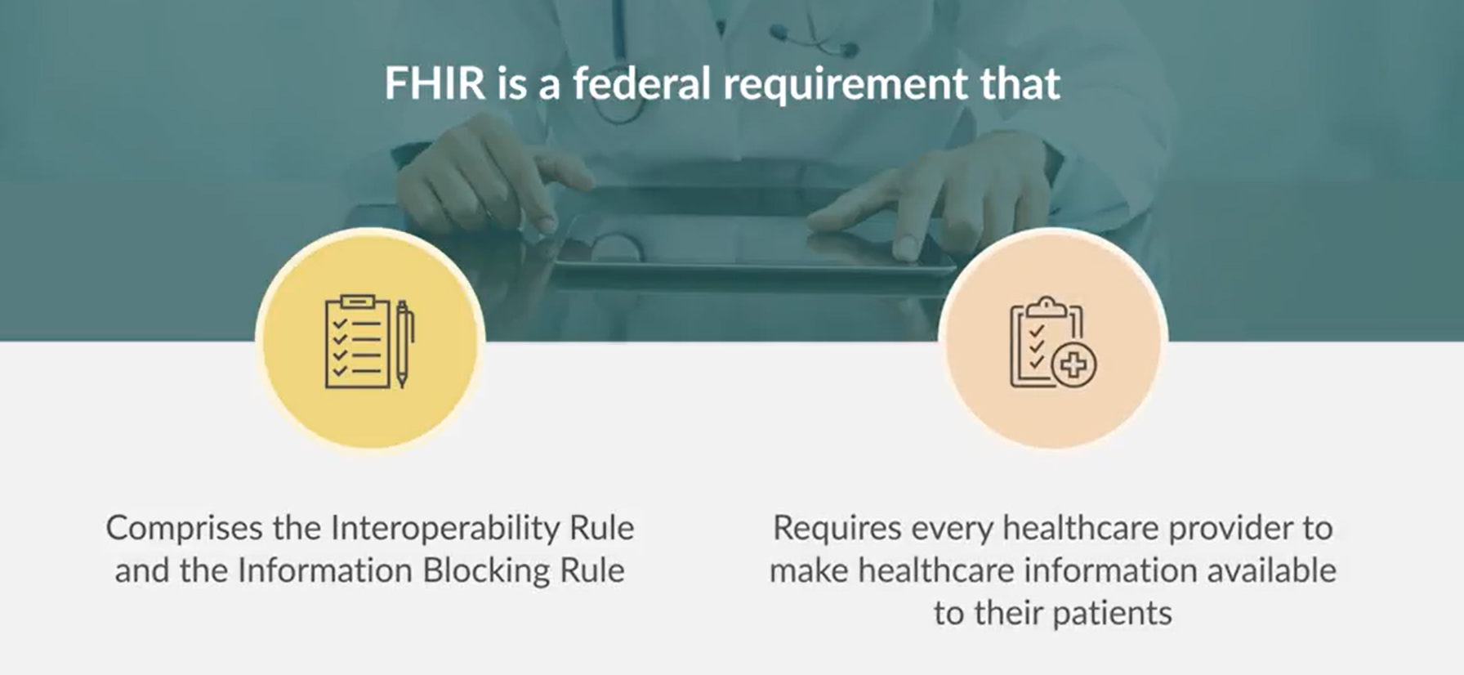

Slide 20
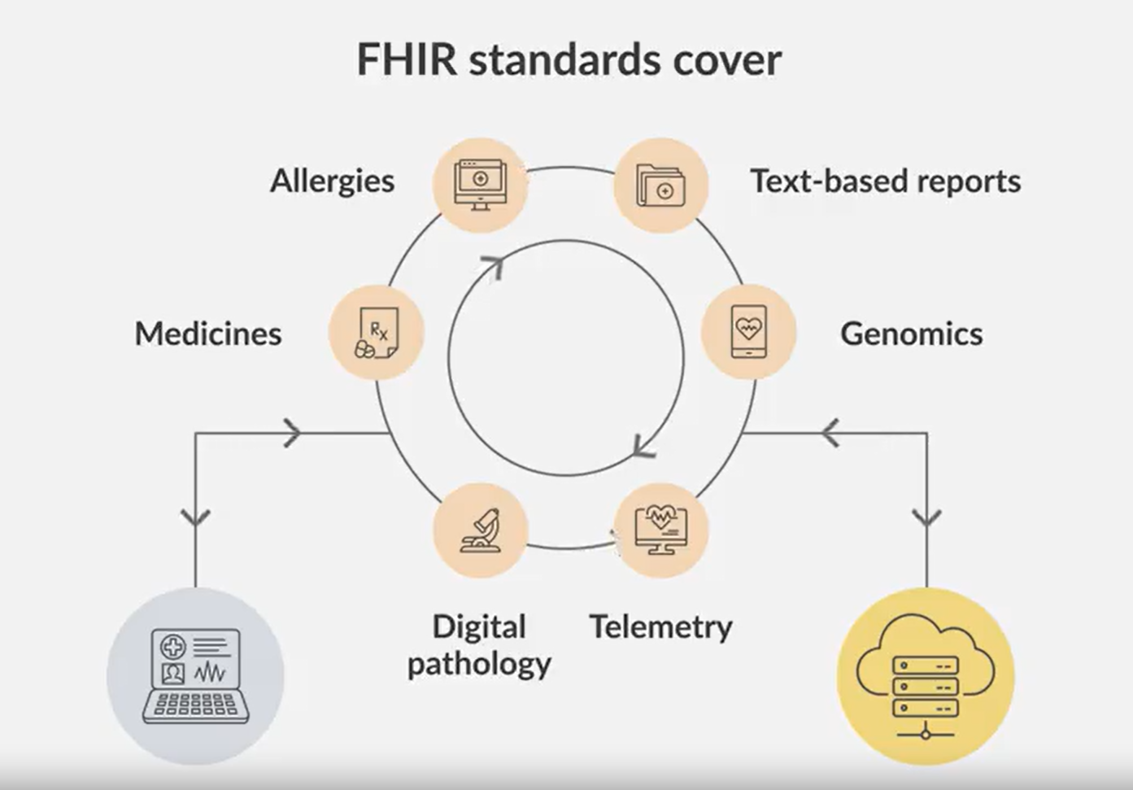

Slide 21
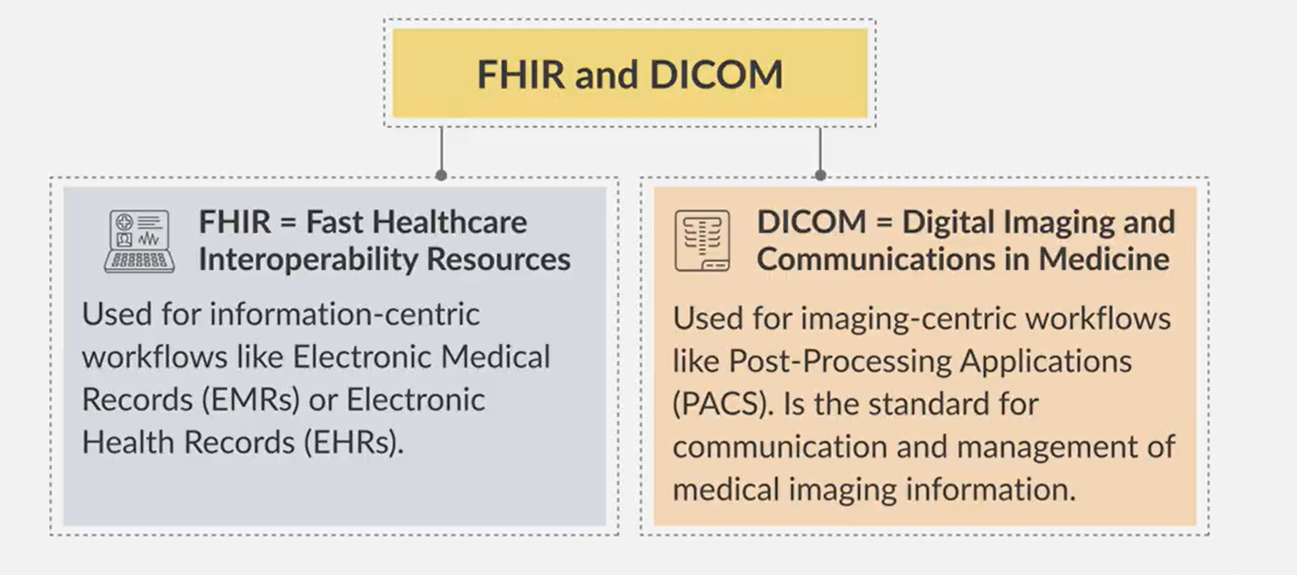

Slide 22
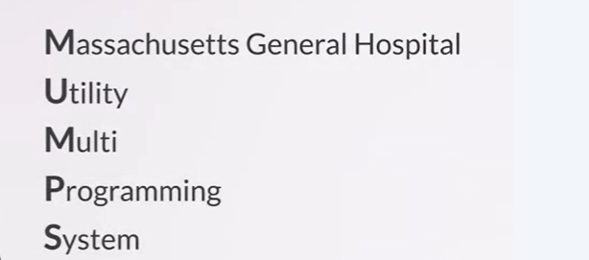

Slide 23
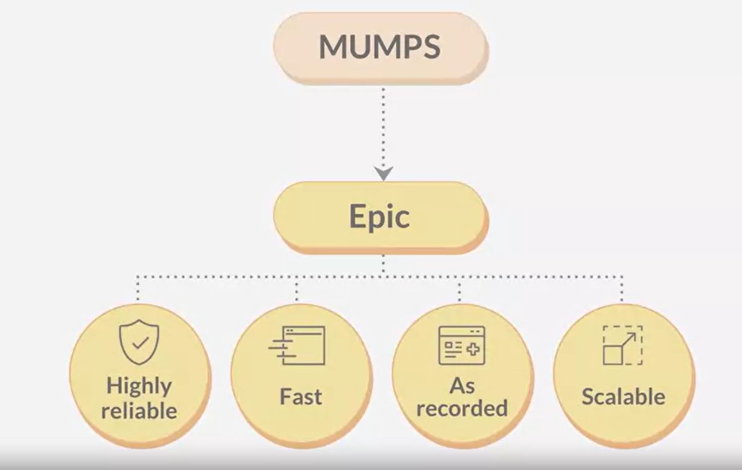

Slide 24
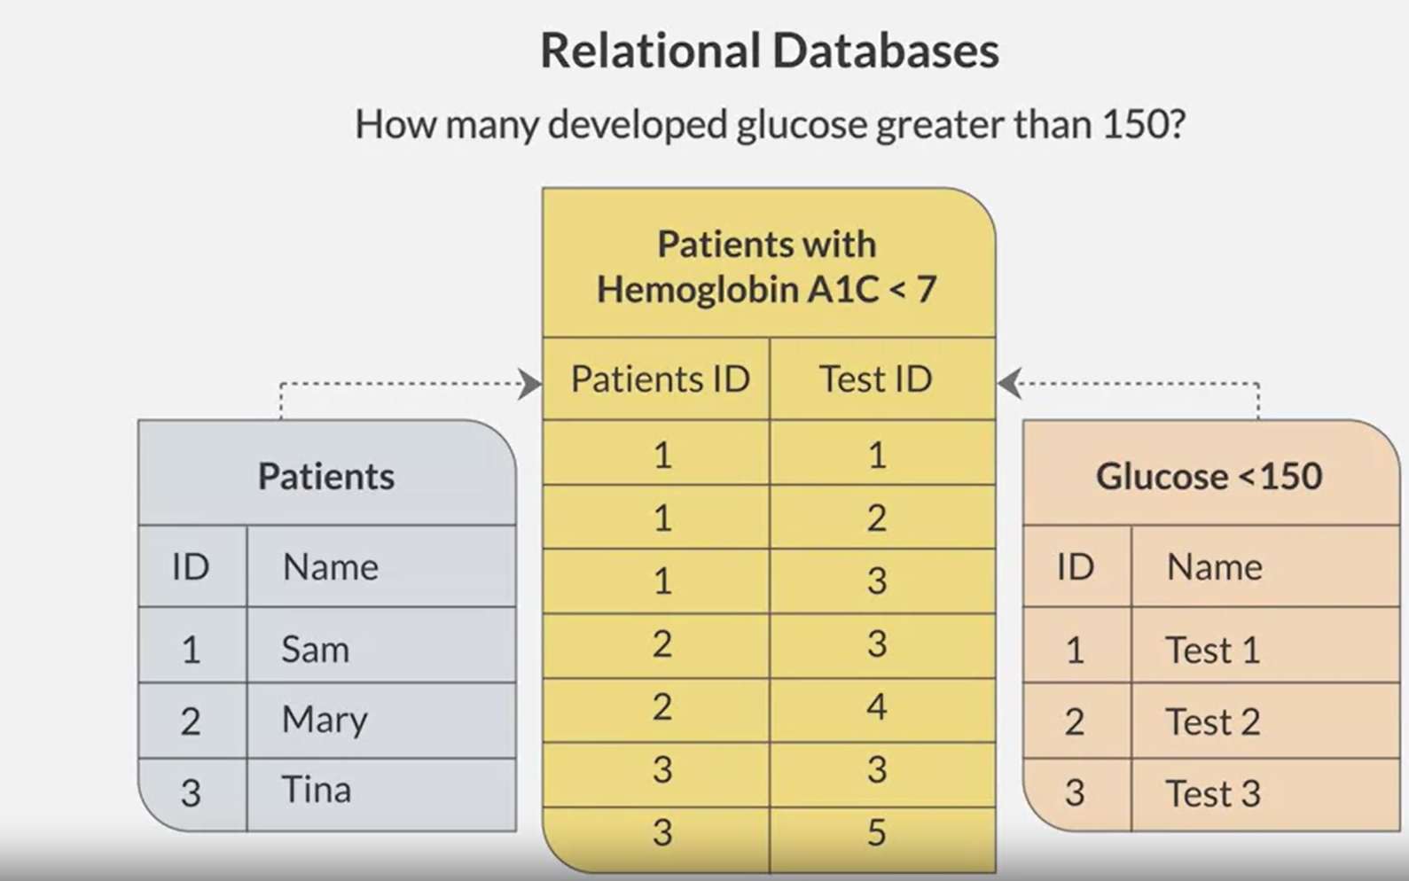

Slide 25
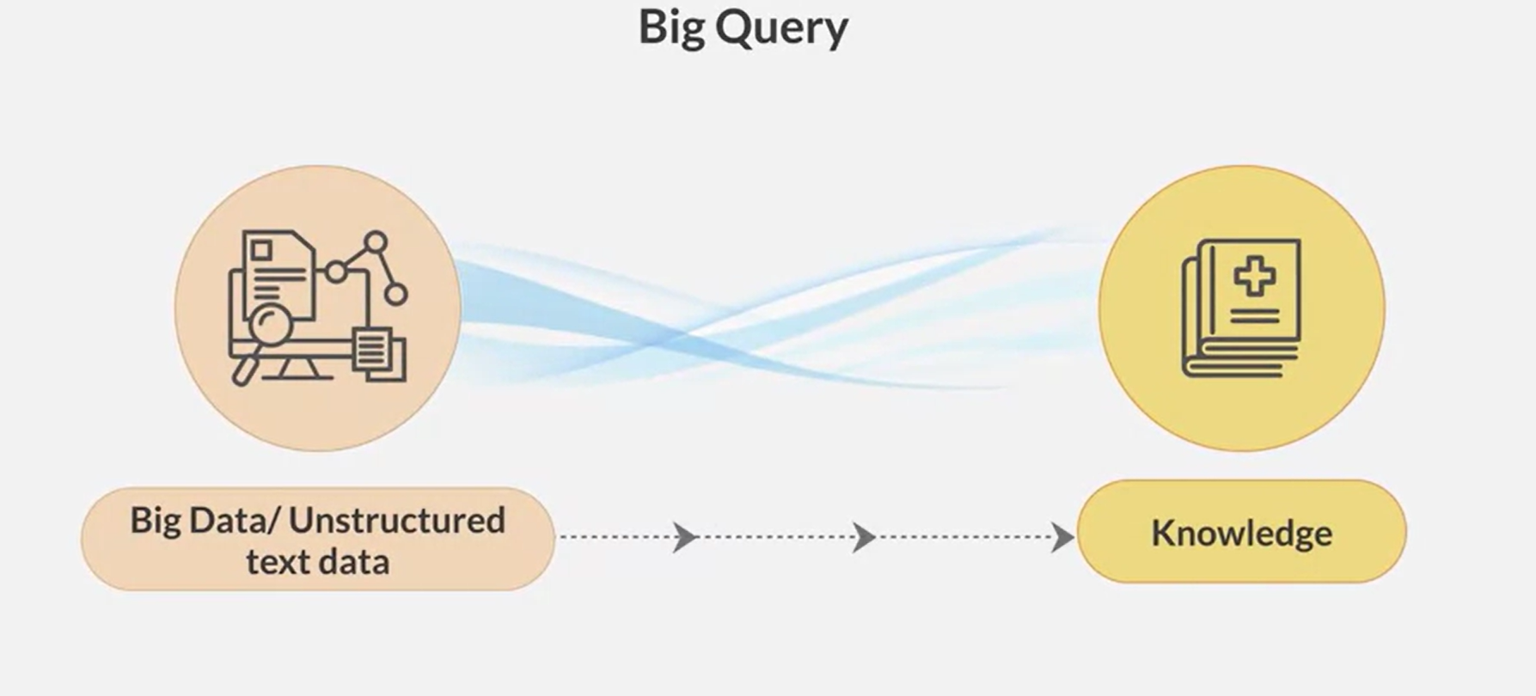

Slide 26
NLP
Natural Language Processing or NLP is a field of Artificial Intelligence that gives the machines the
ability to read,
understand
and derive meaning from human languages.

Slide 27
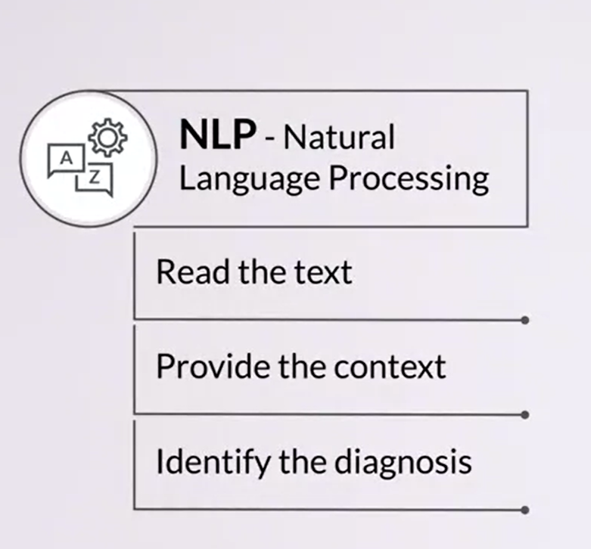
NLP

Slide 28
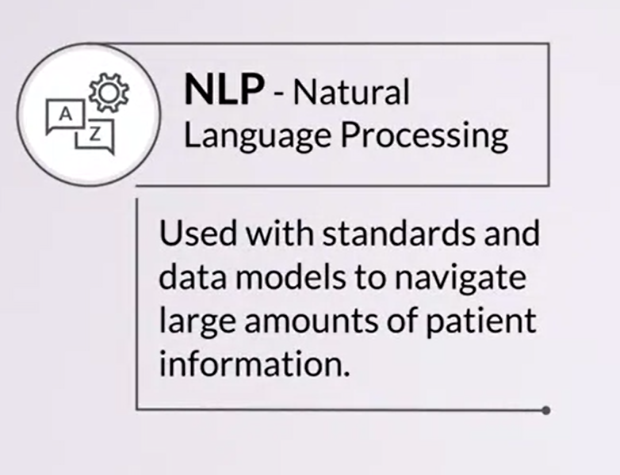

Slide 29
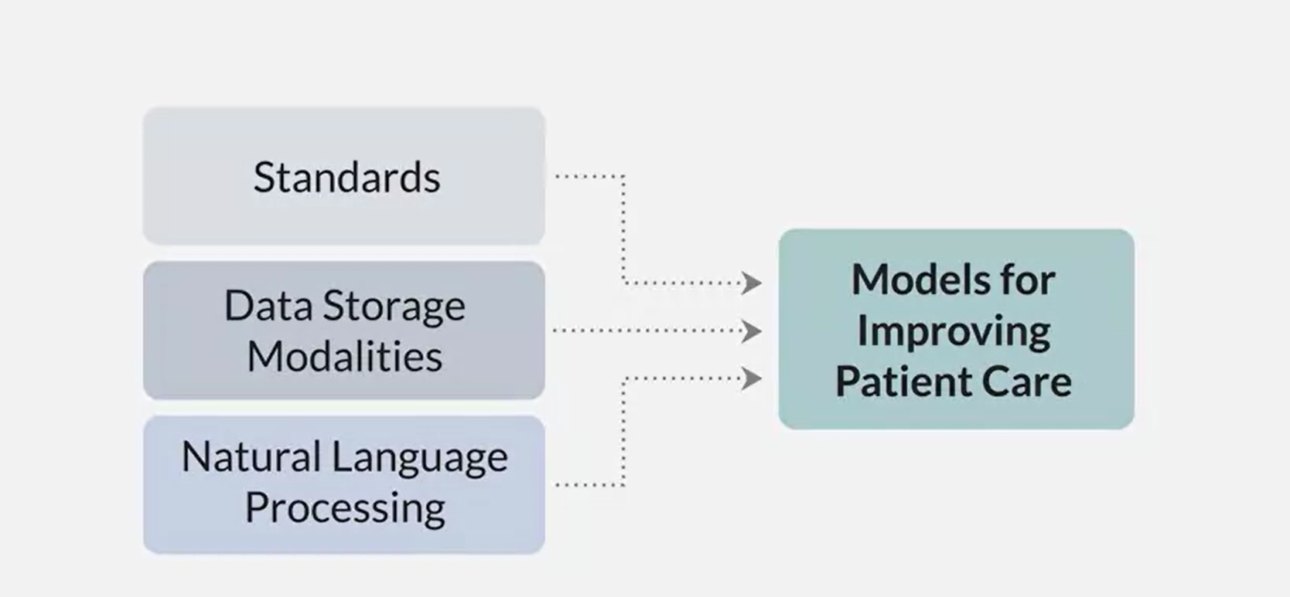

Slide 30
NLP in HealthCare
NLP is particularly booming in the healthcare industry.
This technology is improving care delivery, disease diagnosis and bringing costs down while healthcare organizations are going through a growing adoption of electronic health records.
The fact that clinical documentation can be improved means that patients can be better understood and benefited through better healthcare.
The goal should be to optimize their experience, and several organizations are already working on this.

Slide 31
EHR Data Mapping Exercise:
Activity: Have students work in groups to map out all the types of data included in an EHR. Each group can categorize information (like personal data, medical history, medications) and present their organization and rationale.
Objective: To understand the types of data in EHRs and how they support patient care and decision-making.

Slide 32
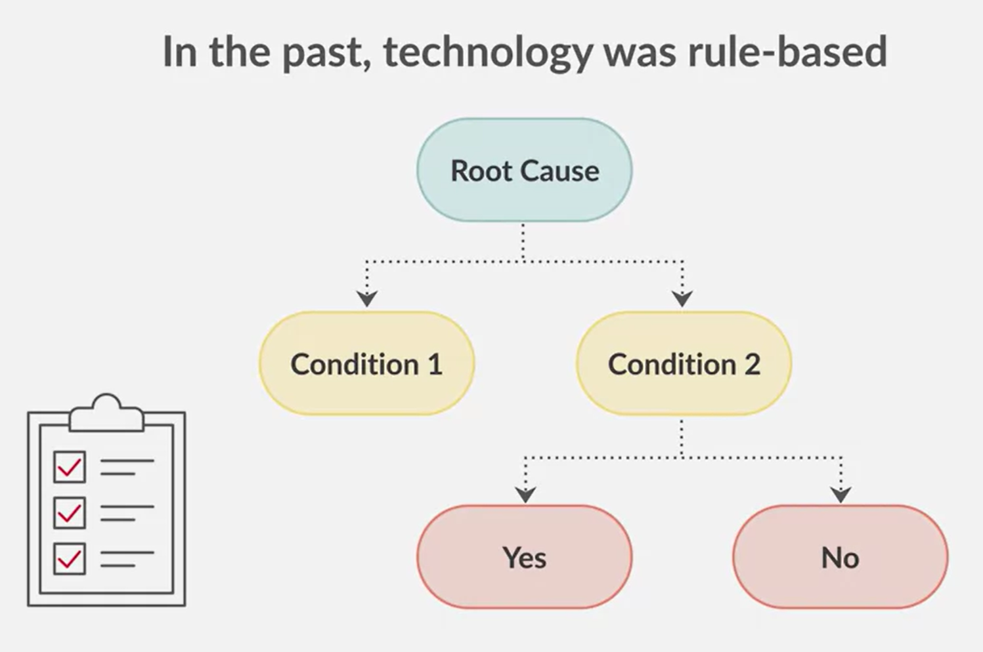
CDS

Slide 33
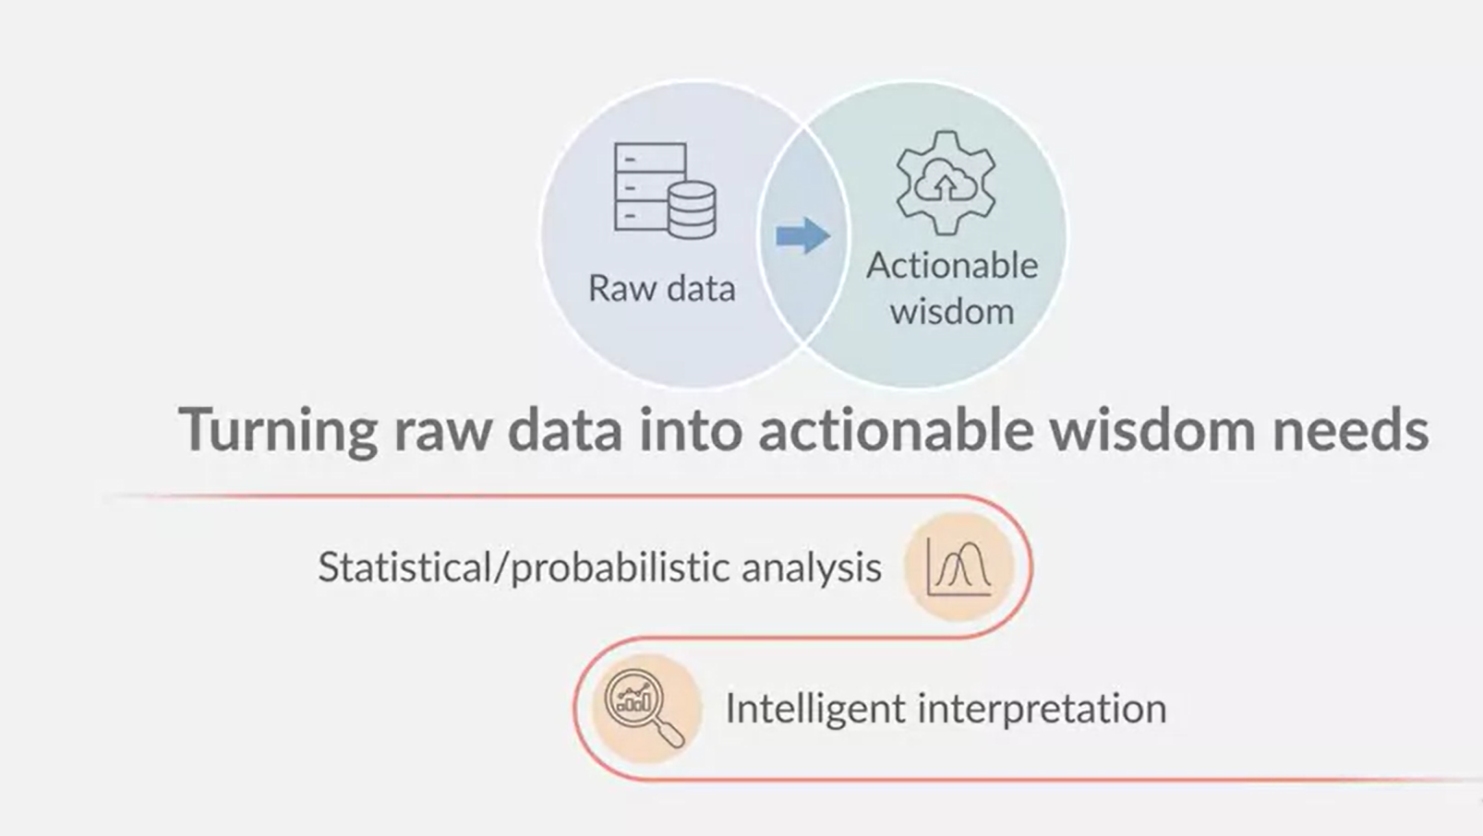

Slide 34
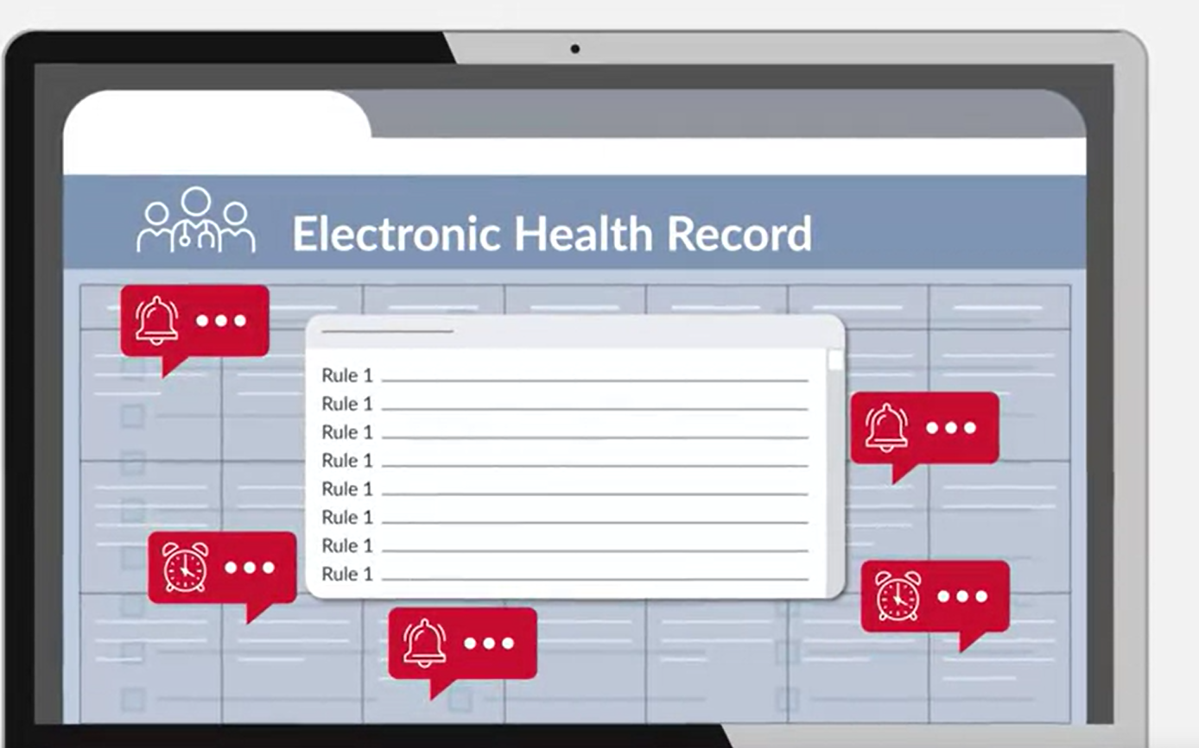

Slide 35
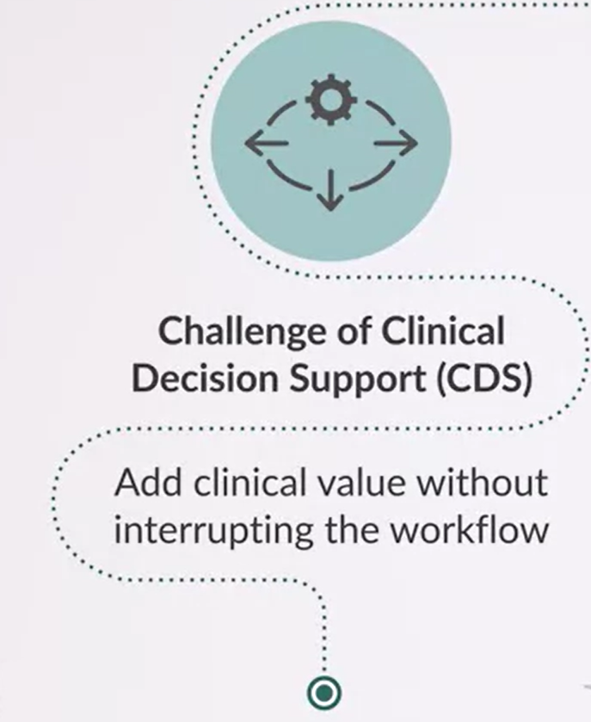

Slide 36
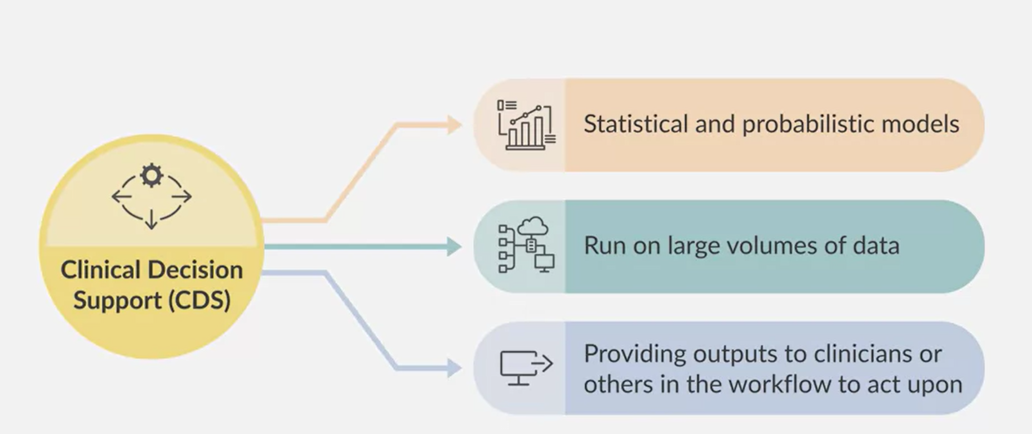

Slide 37
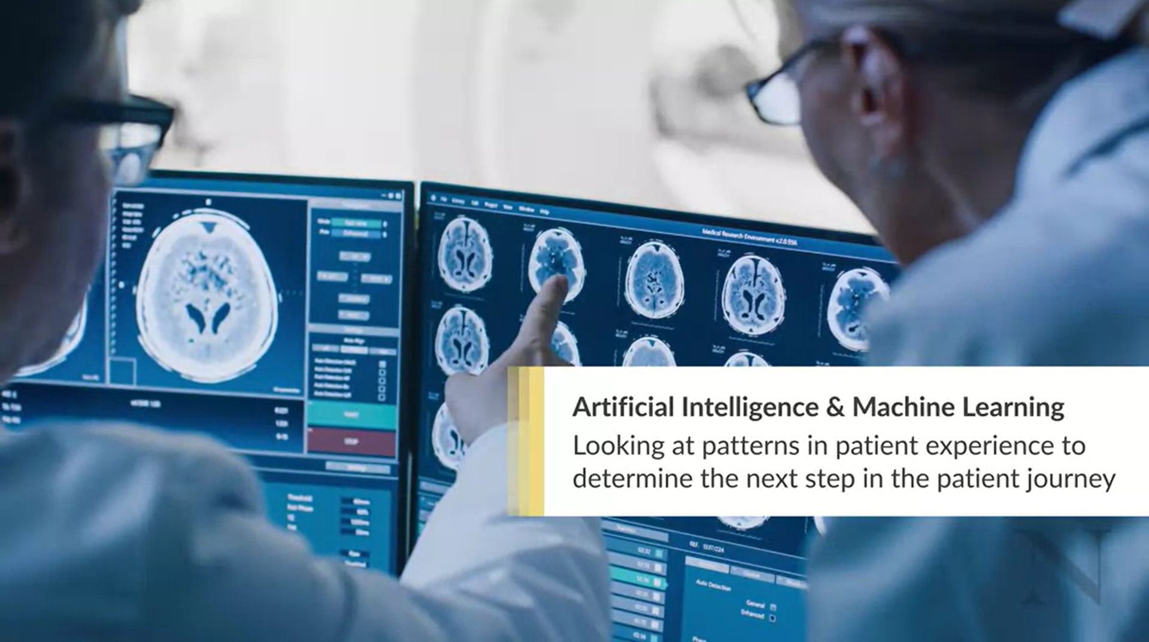

Slide 38
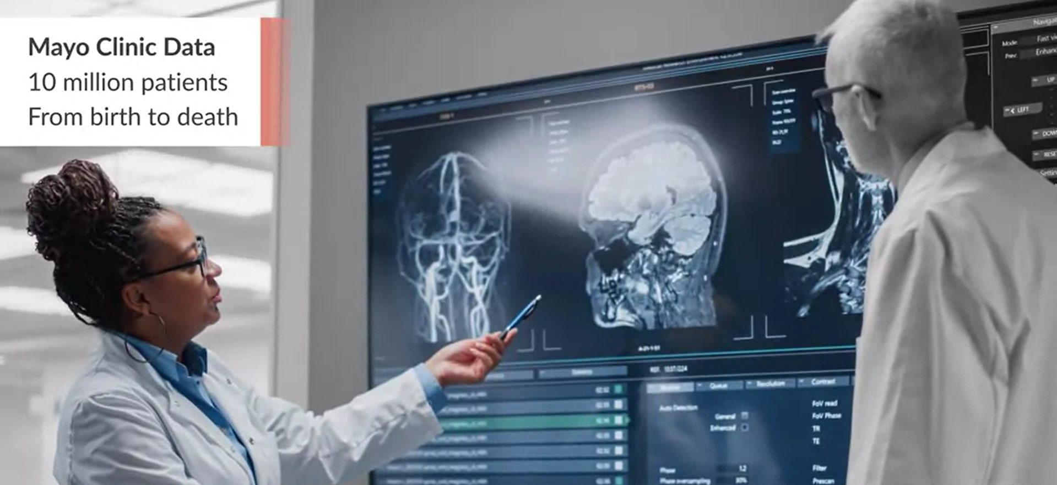

Slide 39
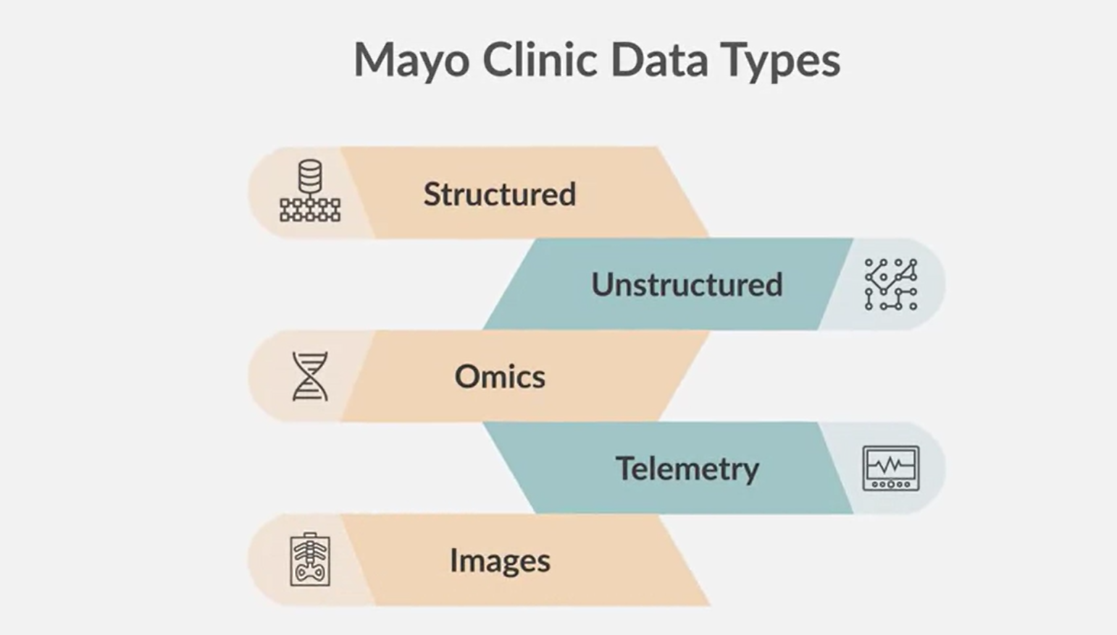

Slide 40
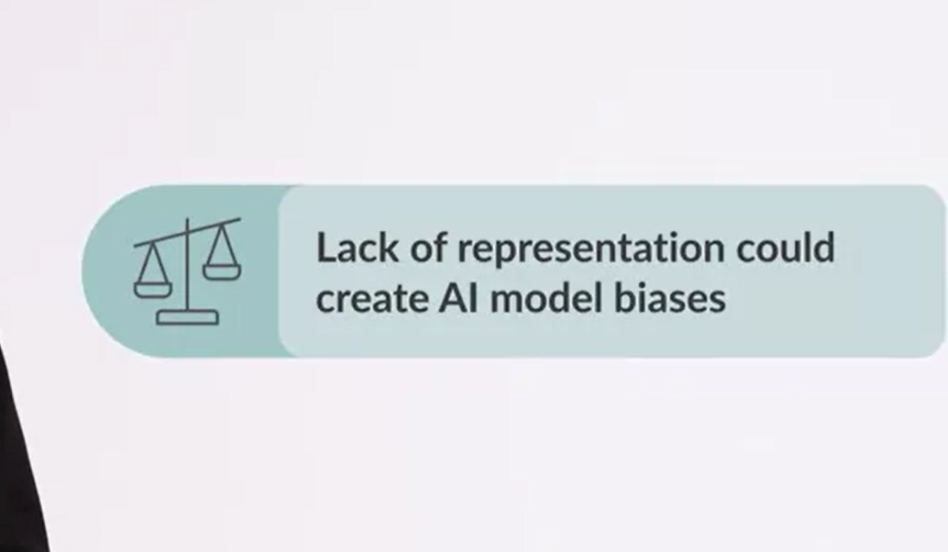

Slide 41
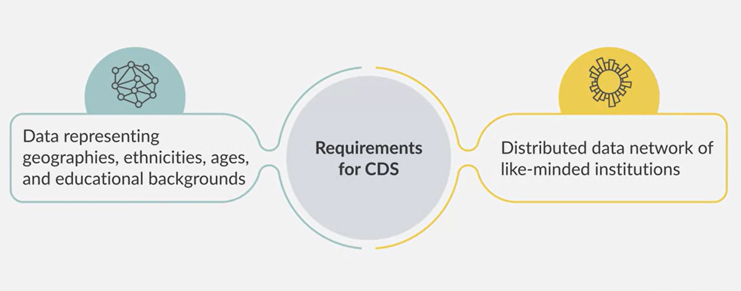

Slide 42
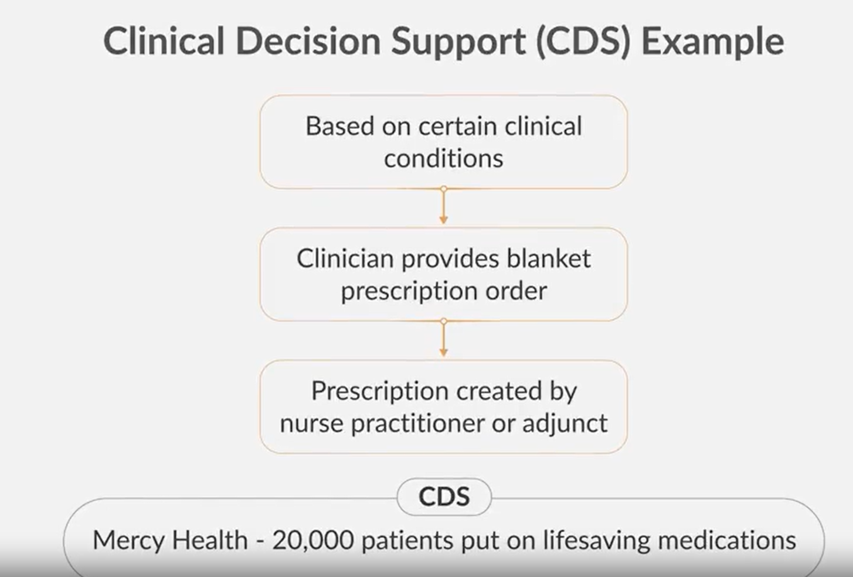

Slide 43
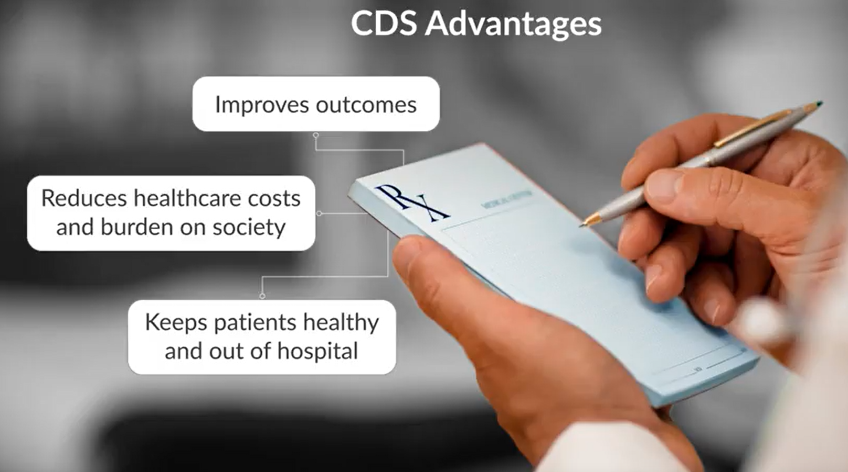

Slide 44
Questioning AI's Role in Healthcare
Common questions:
- Will bots replace doctors?
- Can conversational AI handle clinical interactions?
Assertion: If a doctor can be replaced by a bot, they should be.
- We seek clinicians for respect, listening, and personal touch.
ChatGPT analyzes large data sets but may provide inaccurate information.
- Potential for use, but not a substitute for clinical judgment.

Slide 45
Role of AI in Clinical Decision-Making
Important for clinicians to augment decisions with statistical models.
- Clinicians using AI will likely outperform those who don’t.
Unlikely that AI alone will replace clinicians.
- AI can augment but not replace the human elements of care.
Necessity for ethical guidelines and continuous testing/feedback.
- Multi-stakeholder responsibility (government, academia, industry).

Slide 46
The Coalition for Health AI
Over 150 organizations in Coalition for Health AI.
- Aim: Develop national AI guidelines and guardrails for healthcare.
Embrace AI for its benefits while minimizing risks.
- Ongoing efforts to ensure AI 'does no harm' in healthcare settings.
Encouragement to future healthcare professionals.
- Vision: Next-gen tools will expedite healthcare advancement.

Slide 47
https://www.mayoclinicplatform.org/2022/12/22/the-transformative-power-of-conversational-technologies-part-2/

Slide 48

https://forms.gle/jNGeMnkLFsufRFer9
Assessment - 1

Slide 49
Thank you!

